Slide 1
Final Engagement
Attack, Defense & Analysis of a Vulnerable Network

Slide 2



Our Team
Omorogbe Larry Osagie
Folarin Obikoya
Naveen Kandimalla

Slide 3
Contents
Network Traffic Analysis
Wireshark
Network Topology
Critical Vulnerabilities
Traffic Profile
Normal Activity
Malicious Activity
References

Slide 4
Network Traffic Analysis (NTA)
# What is Network Traffic Analysis (NTA)?
Network traffic analysis (NTA) is a method of monitoring network availability and activity to identify anomalies, including security and operational issues.
# Common use cases for NTA include:
Collecting a real-time and historical record of what’s happening on your network
Detecting malware such as ransomware activity
Detecting the use of vulnerable protocols and ciphers
Troubleshooting a slow network
Improving internal visibility and eliminating blind spots
# Monitoring the network traffic, gives you the insight you need to optimize network performance, minimize your attack surface, enhance security, and improve the management of your resources. However, knowing how to monitor network traffic is not enough.
It’s important to also consider the data sources for your network monitoring tool; two of the most common are flow data (acquired from devices like routers) and packet data (from SPAN, mirror ports, and network TAPs)
# Benefits of NTA
Improved visibility into devices connecting to your network
Meet compliance requirements
Troubleshoot operational and security issues
Respond to investigations faster with rich detail and additional network context
NTA
The network is a critical element of their attack surface; gaining visibility into their network data provides one more area they can detect attacks and stop them early.

Slide 5

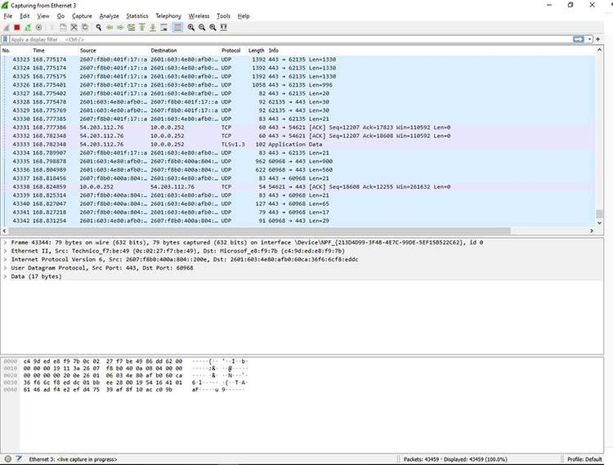
WIRESHARK
What Is Wireshark?
Wireshark is a network protocol analyzer, or an application that captures packets from a network connection, such as from your computer to your home office or the internet. Packet is the name given to a discrete unit of data in a typical Ethernet network.
Wireshark is the most often-used packet sniffer in the world. Like any other packet sniffer, Wireshark does three things:
Packet Capture: Wireshark listens to a network connection in real time and then grabs entire streams of traffic – quite possibly tens of thousands of packets at a time.
Filtering: Wireshark is capable of slicing and dicing all of this random live data using filters. By applying a filter, you can obtain just the information you need to see.
Visualization: Wireshark, like any good packet sniffer, allows you to dive right into the very middle of a network packet. It also allows you to visualize entire conversations and network streams.
Wireshark on a network are kind of like those who use flashlights to see what cool things they can find. After all, when using Wireshark on a network connection (or a flashlight in a cave), you’re effectively using a tool to hunt around tunnels and tubes to see what you can see.

Slide 6
Network Topology and
Critical Vulnerabilities

Slide 7
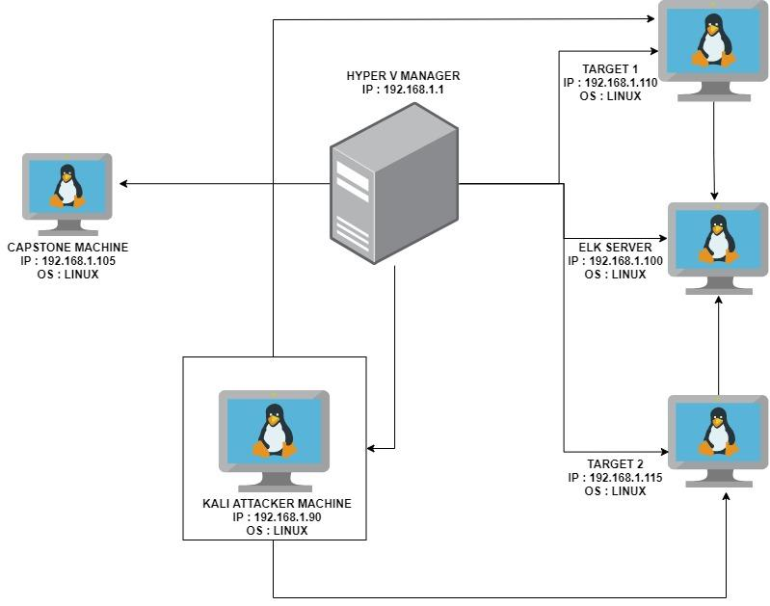
Network Topology
Network
Address Range: 192.168.1.0/24
Netmask: 255.255.255.255
Gateway: 10.0.0.1
Machines
IPv4: 192.168.1.90
OS: LINUX
Hostname: KALI
IPv4: 192.168.1.100
OS: LINUX
Hostname: ELK
IPv4: 192.168.1.110
OS: LINUX
Hostname: TARGET 1
IPv4: 192.168.1.115
OS: LINUX
Hostname: TARGET 2

Slide 8
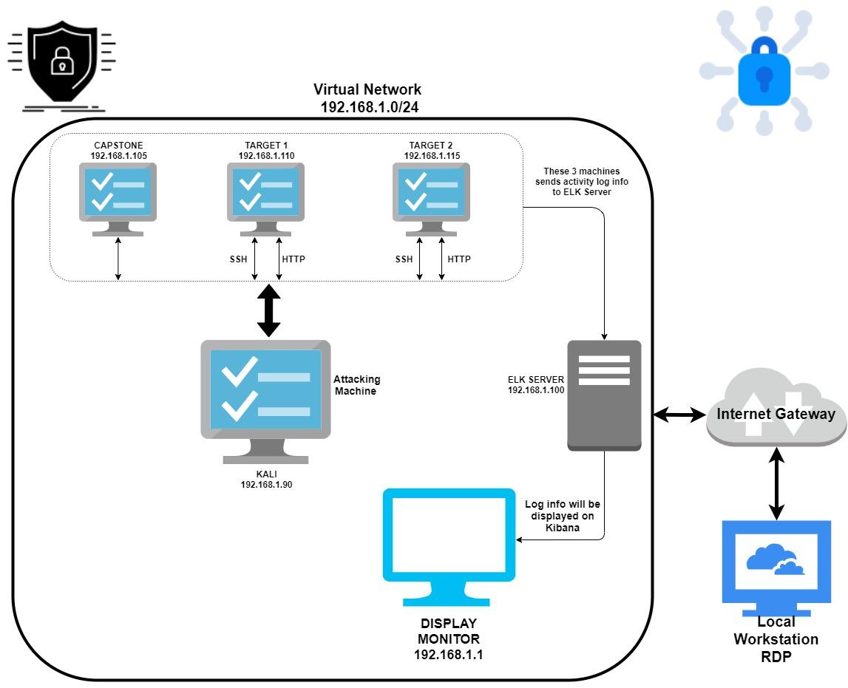
Network Topology
Network
Address Range: 192.168.1.0/24
Netmask: 255.255.255.255
Gateway: 10.0.0.1
Machines
IPv4: 192.168.1.90
OS: LINUX
Hostname: KALI
IPv4: 192.168.1.100
OS: LINUX
Hostname: ELK
IPv4: 192.168.1.110
OS: LINUX
Hostname: TARGET 1
IPv4: 192.168.1.115
OS: LINUX
Hostname: TARGET 2

Slide 9
Critical Vulnerabilities: Target 1
Our assessment uncovered the following critical vulnerabilities in Target 1.
Vulnerability | Description | Impact
Weak Passwords | Found the password of the user easily by guessing aka Dictionary password attack | Attacker can guess the password or use a dictionary attack to gain access very easily to the system
WordPress User Enumeration | With WP scan we are able to gather the information of the users that have access | An attacker will gain access to users on the site and any vulnerabilities related to the word press site.
Privilege Escalation | Able to escalate to root using simple python Script that granted us admin access to all the system files and Data | With root access, an attacker can inflict major damages to a compromised machine.
WordPress configuration file for SQL databases stored in plain text. | The username and password for the sql database was stored in plain text in the wp-config.php file | This grants an attacker access to the sql database and sensitive information.
Ports are Open | Nmap scan revealed that port 22, 80, 111, 139 and 445 are open on the server. | attacker could utilize readily available exploits to access the services running on those ports and gain access to the server

Slide 10
Critical Vulnerabilities: Target 2
Our assessment uncovered the following critical vulnerabilities in Target 2.
Vulnerability | Description | Impact
Vulnerability to URL Brute Force | This vulnerability allows an attacker to brute force and discover directories on a server | The attacker can gain access to hidden directories within the server.
Exploring the Directories in Webpage | This tool is used to brute-force directories and files and DNS sub-domains. It also can search virtual host names on target web servers. | Can find out the directories in a webpage where the users have access and can see/steal valuable information
Netcat Reverse Shell and Remote Code Execution | A bash script was uploaded to the server, using a netcat listener and the browser, a reverse shell was achieved. | A reverse shell will grant an attacker unauthorized access to the server and to sensitive data
Ports are Open | Nmap scan revealed that port 22, 80, 111, 139 and 445 are open on the server. | attacker could utilize readily available exploits to access the services running on those ports and gain access to the server

Slide 11

Traffic Profile
‹#›

Slide 12
Traffic Profile
Our analysis identified the following characteristics of the traffic on the network:
Feature | Value | Description
Top Talkers (IP Addresses) | 172.164.205, 185.243.115.84 | Machines that sent the most traffic.
Most Common Protocols | TCP , UDP and TLSv1.2 | Three most common protocols on the network.
# of Unique IP Addresses | 810 | Count of observed IP addresses.
Subnets | 172.16.4.0/24, 10.0.0.0/24, 10.6.12.0/24 | Observed subnet ranges.
# of Malware Species | 49 | Number of malware binaries identified in traffic.
Notes:
You may have more than 2 subnets.

Slide 13
Behavioral Analysis
Purpose of Traffic on the Network
Users were observed engaging in the following kinds of activity.
“Normal” Activity
Watching youtube
visiting google.com
Downloading images
visiting music websites
Suspicious Activity
Setting up an Active Directory network
Downloading malware
copyright infringement downloads using torrents.

Slide 14
Normal Activity
‹#›

Slide 15






Normal Behavior Activity
What kind of traffic did you observe? Which protocol(s)?
Lots of Traffic related to YouTube. Music Sharing site. TLSV1.2 and TCP
What, specifically, was the user doing? Which site were they browsing? Etc.
Watching YouTube videos, Listening to music. YouTube .com

Slide 16
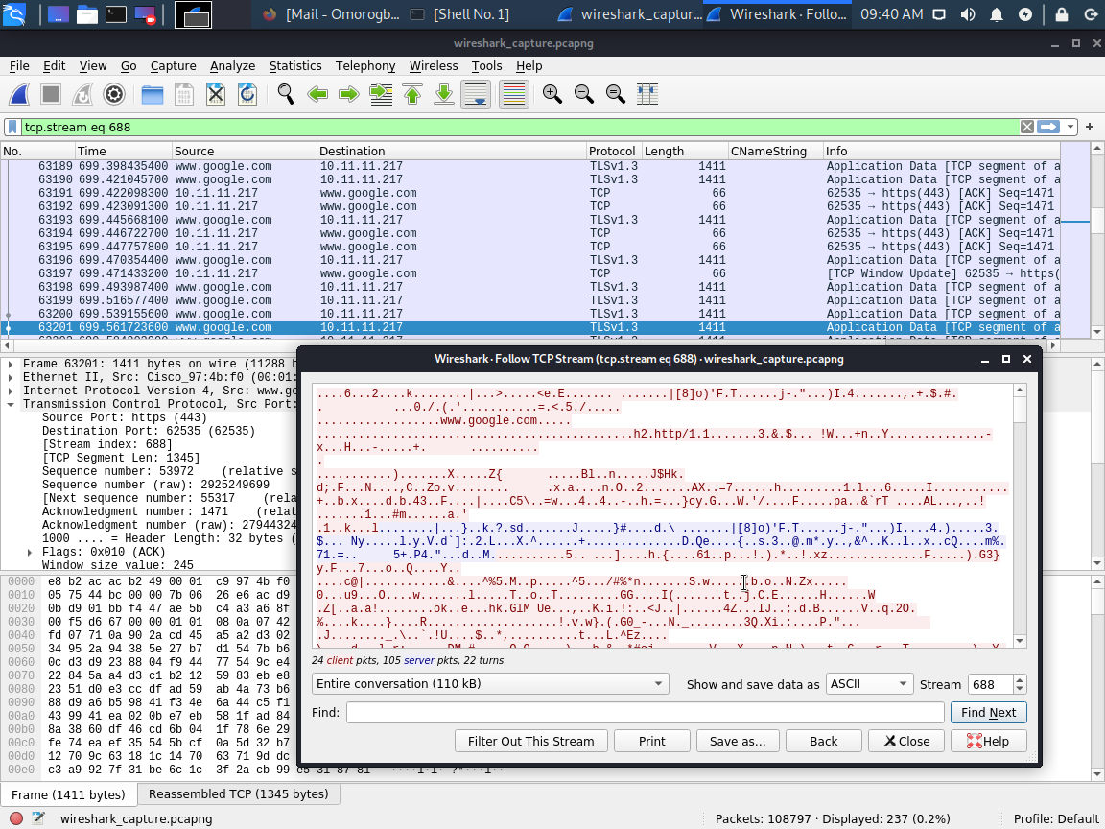
VISITING GOOGLE.COM
Summary
There was significant traffic to google.com using TCP and TLSv1.3 protocol. This is regarded as a normal activity. Users seem to be seeking information about different things.

Slide 17
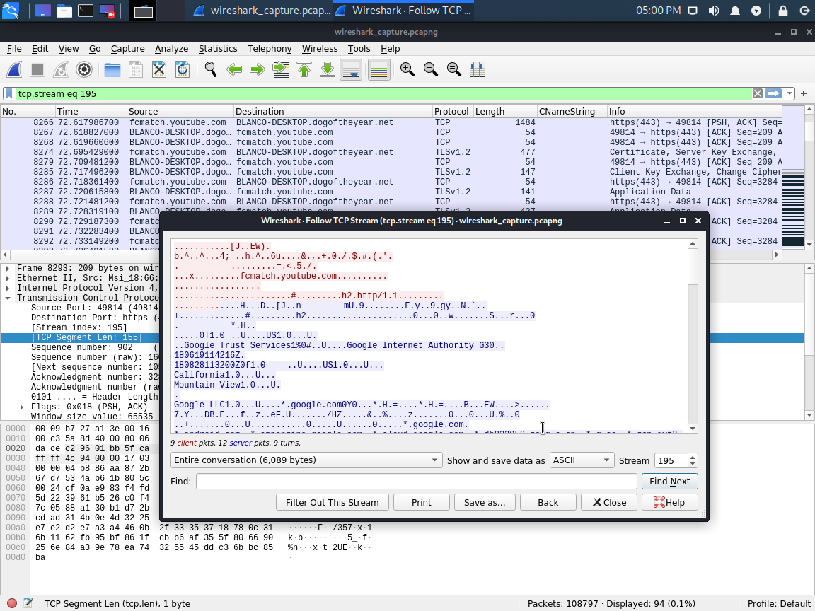
WATCHING YOUTUBE.COM
Summary
There was significant traffic to youtube.com over TLSv1.2 and TCP protocol.

Slide 18
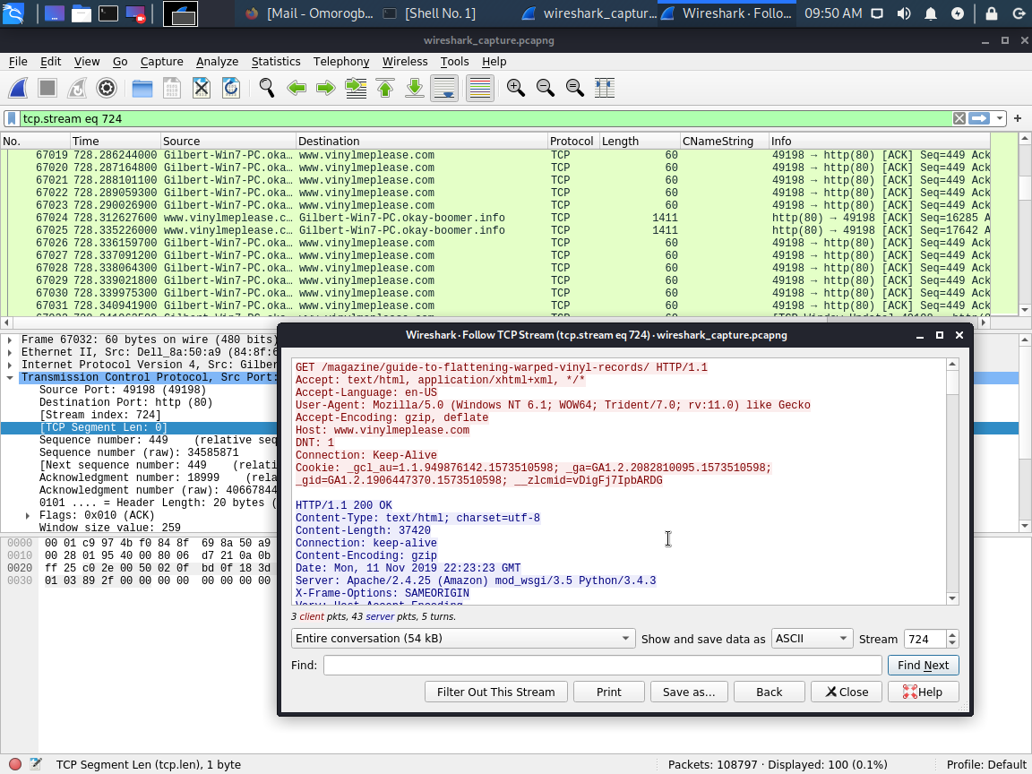
VISITING MUSIC WEBSITES.
Summary
There was also significant traffic to a musical website called vinylmeplease.com via TCP protocol. this is a music subscription sites. User were listening to and downloading music.

Slide 19

Malicious Activity
‹#›

Slide 20


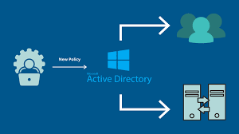
Malicious Activity Behavior
Summarize the following:
What kind of traffic did you observe? Which protocol(s)?
Accessing Trojan Malware, setting up Active Directory,
What, specifically, was the user doing? Which site were they browsing? Etc.
Installing Trojan Malware, Illegal Downloads

Slide 21
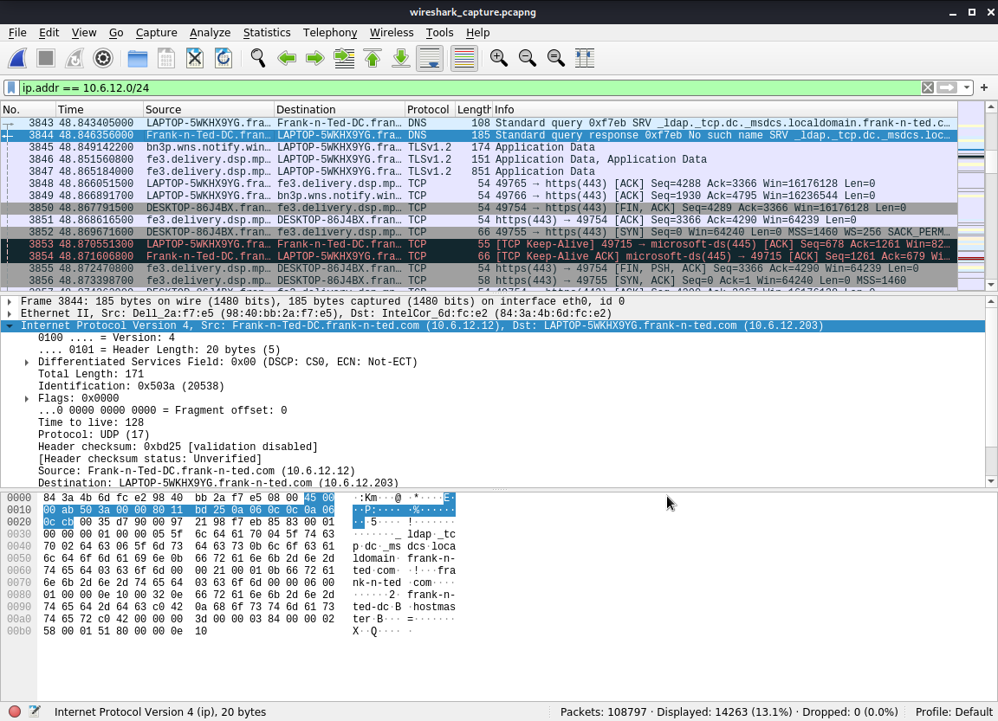
SETTING UP AN ACTIVE DIRECTORY NETWORK.
Summary :
It was observed that an active directory network has been created within the corporate network. Further investigation revealed the AD network to be : frank-n-ted.com. The domain controller of this AD is located at this IP address : 10.6.12.12.

Slide 22
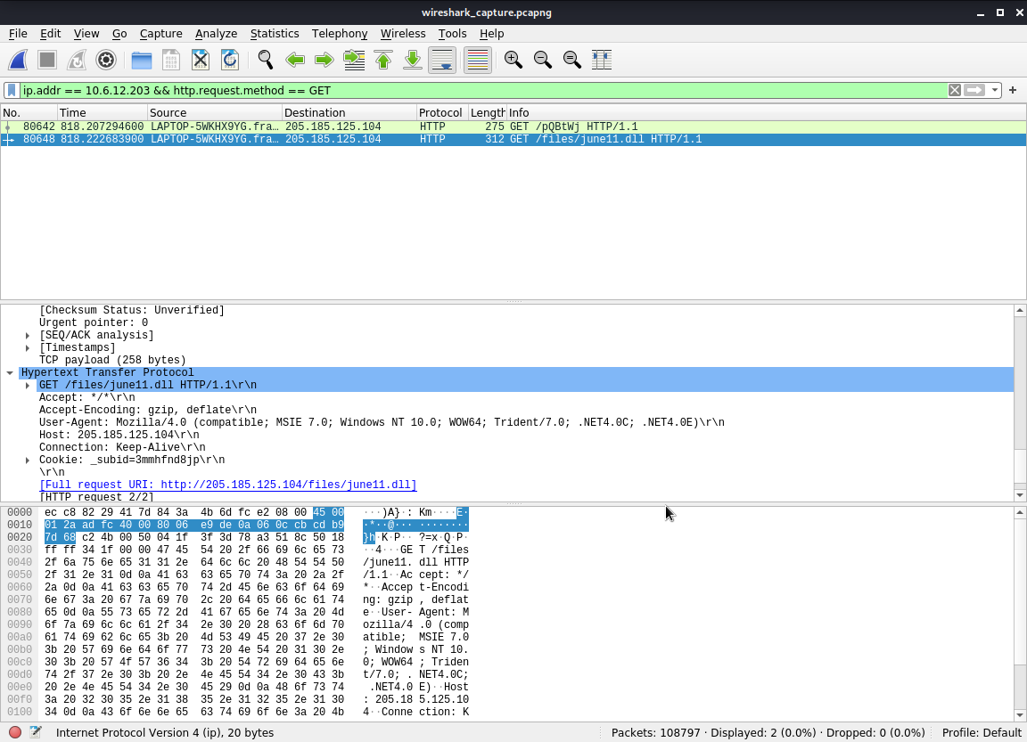
DOWNLOADING MALWARE
Summary :
The ip address : 10.6.12.203 downloaded a malware (june11.dll) onto his system over HTTP protocol. It was downloaded from this ip address : 205.185.125.104. Further investigation into the malware revealed it was Trojan.

Slide 23
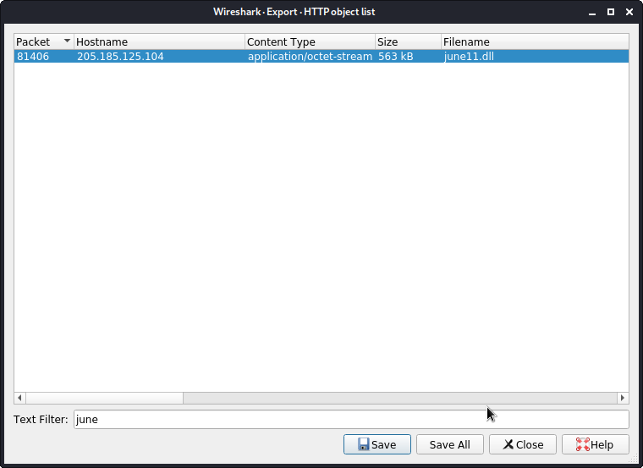
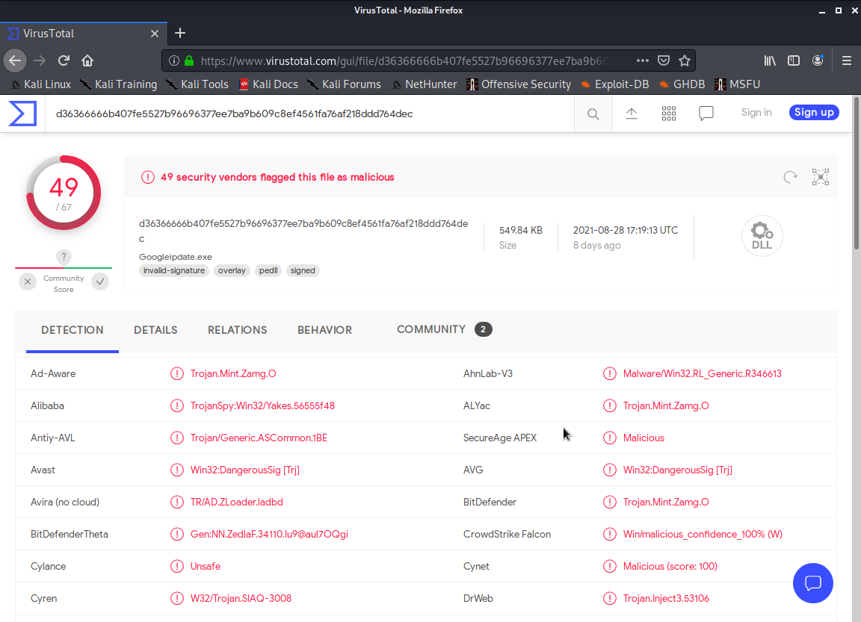
DOWNLOADING MALWARE
Summary : screenshots
Malware being exported for investigation Malware revealed to be a TROJAN by virustotal.com

Slide 24
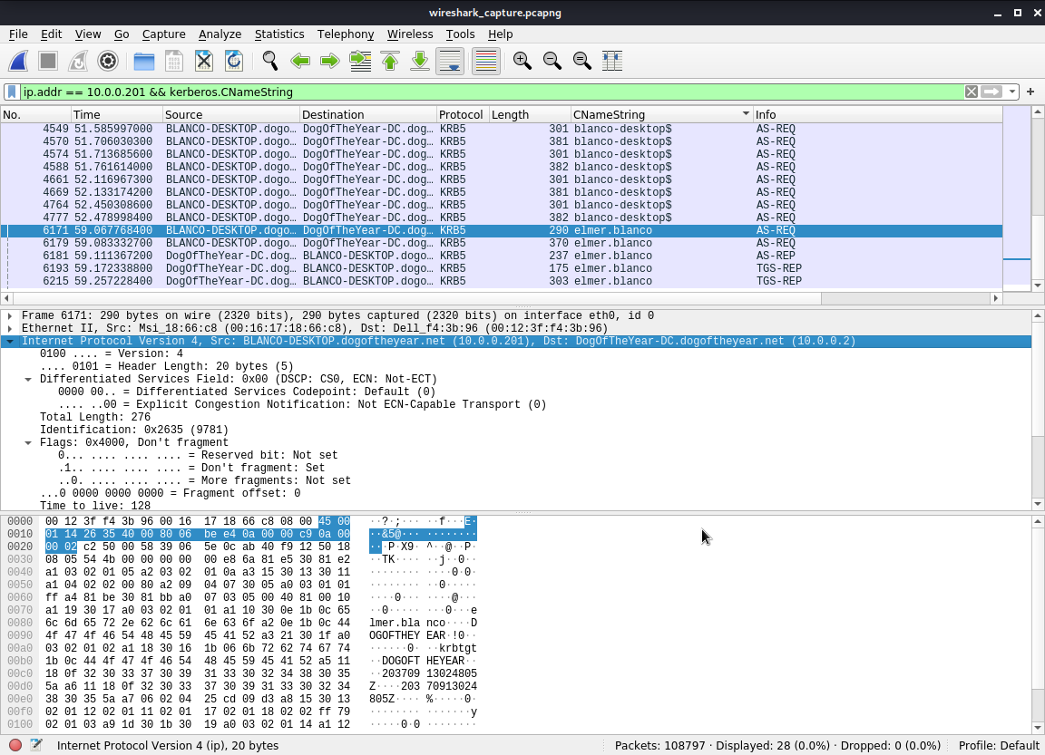
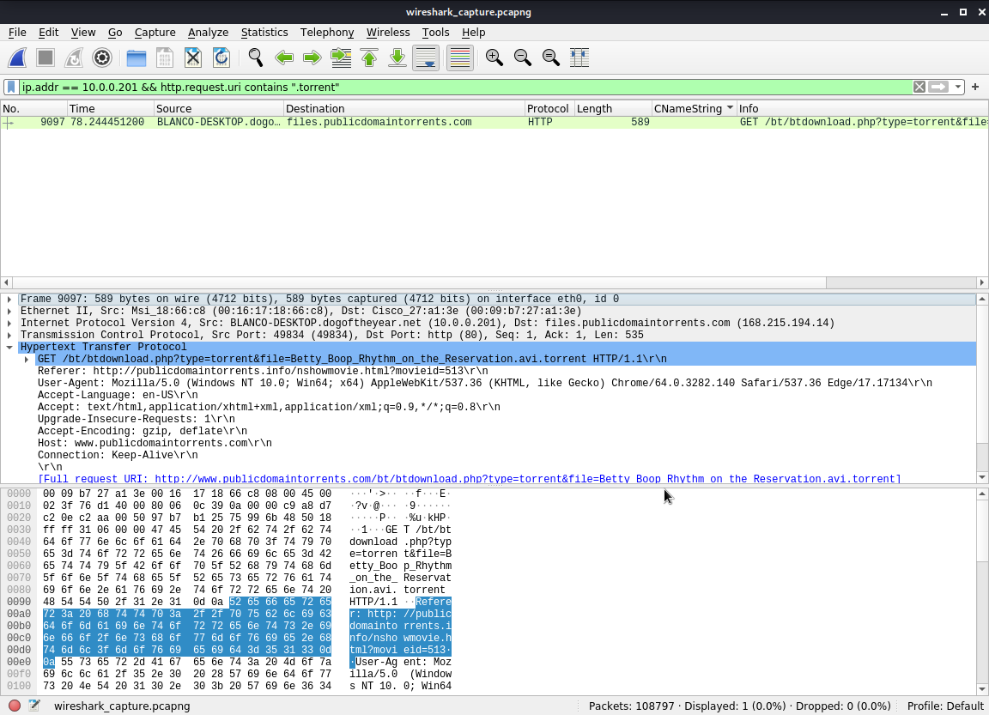
COPYRIGHT INFRINGEMENT DOWNLOADS USING TORRENTS
Summary :
A user on the network used torrents to download a file that breaches the copyright infringements policy of the company. the user uses a windows machine with username : elmer.blanco, IP : 10.0.0.201. The torrent file downloaded was : Betty_Boop_Rythm_on_the_Reservation.avi.torrent.
uncovering the windows username uncovering the illegal file downloaded through torrents.

Slide 25

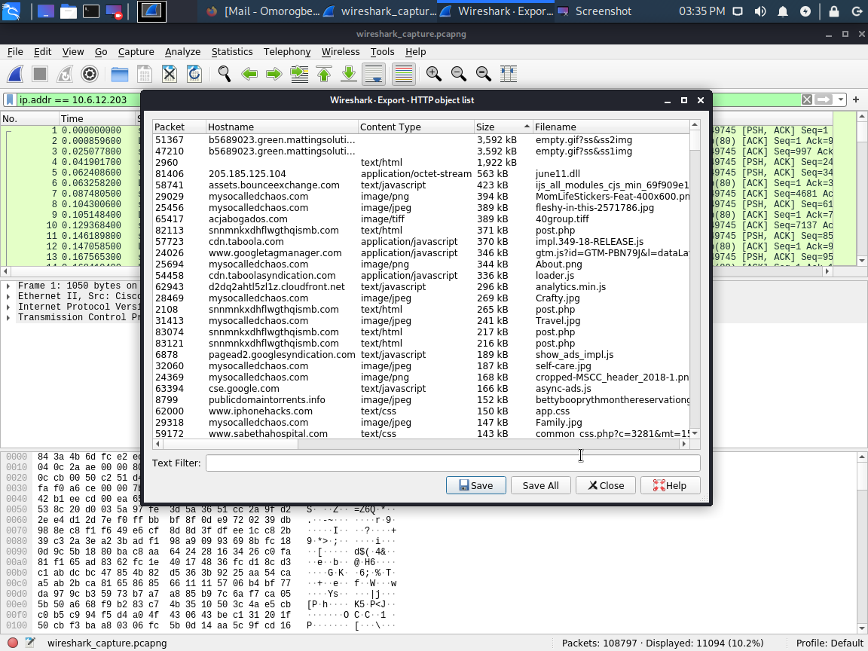
OPTIONAL ACTIVITY
DESKTOP BACKGROUND
I was able to get the desktop background image for the windows user with IP : 10.6.12.203.

Slide 26
References
https://geekflare.com/nikto-webserver-scanner/
https://www.rapid7.com/fundamentals/network-traffic-analysis/
https://www.wireshark.org/
https://www.comptia.org/content/articles/what-is-wireshark-and-how-to-use-it

Slide 27




‹#›

Slide 28
THANK YOU
“ One Single Vulnerability is all an attacker needs.”
“At the end of the day, the goals are simple : Safety and Security.”

